Slide 1

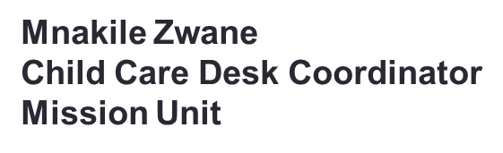
Superintendents Workshop

Slide 2

Introduction & Purpose
Definition of safeguarding in a church context
Safeguarding is about the action the Church takes to promote a safer culture.
It is integral to the mission of the Methodist Church and a part of its response and witness to the love of God in Christ.
Why safeguarding matters for MCSA ministers
Safeguarding is not something we do because we have to, but because it relates to the heart of Christian faith.
Everyone associated with the Methodist Church has a role to play in promoting the welfare of children, young people and adults ,in working to prevent abuse from occurring, and in seeking to protect and respond well to those who have been abused.
Compliance with safeguarding procedures and policies is part of faithful discipleship.

Slide 3
Who Needs Safeguarding?
Children and Youth
Vulnerable adults( Elderly, disabled , mental unwell
Congregants in distress
Financially vulnerable

Slide 4
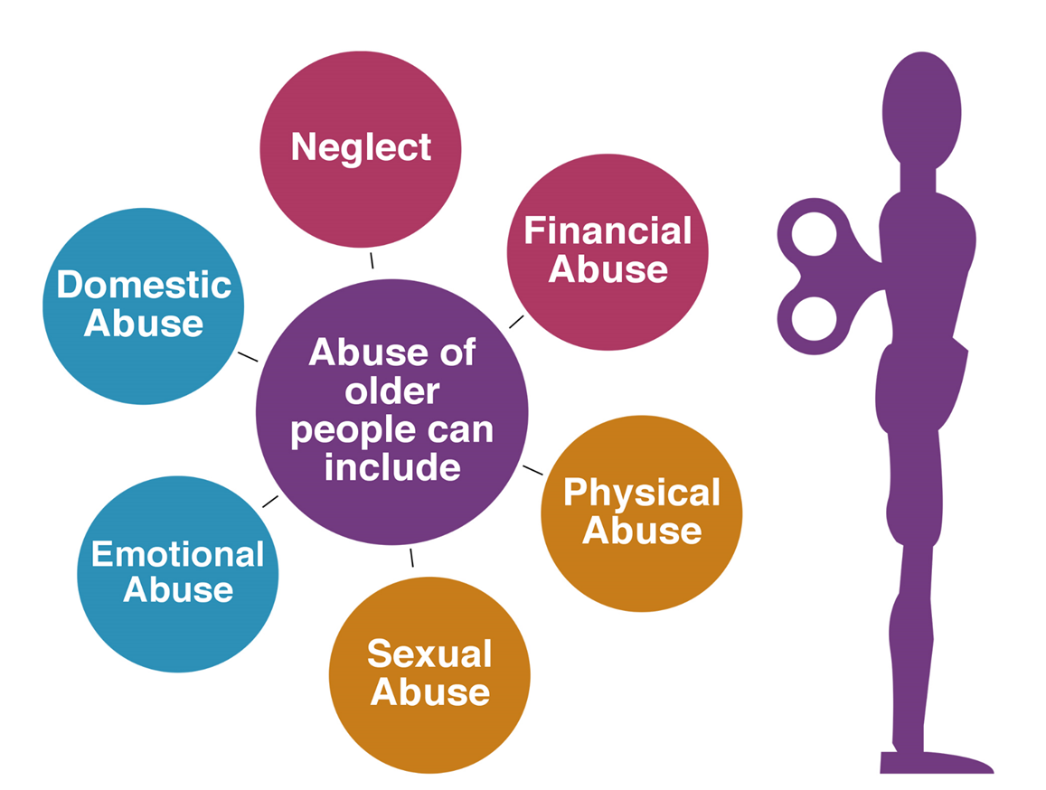
Types of Harm

Slide 5
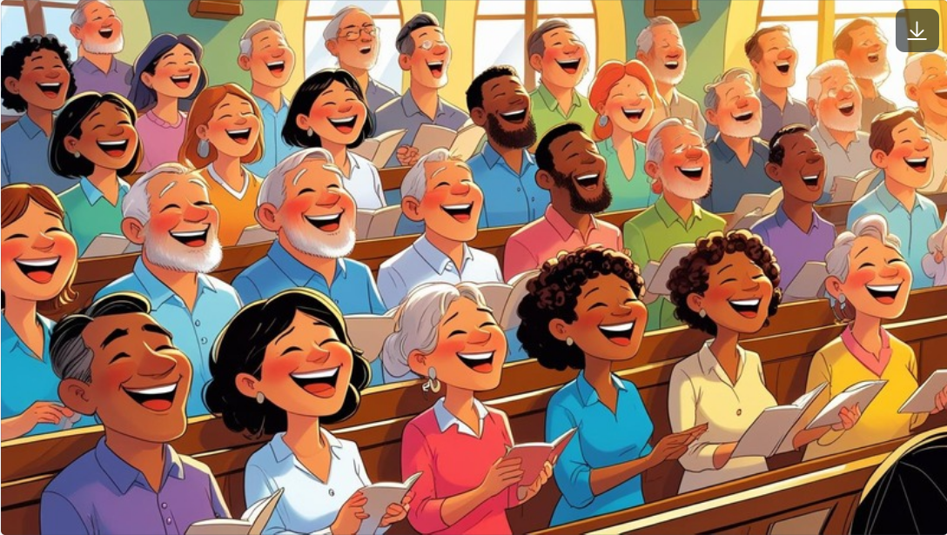
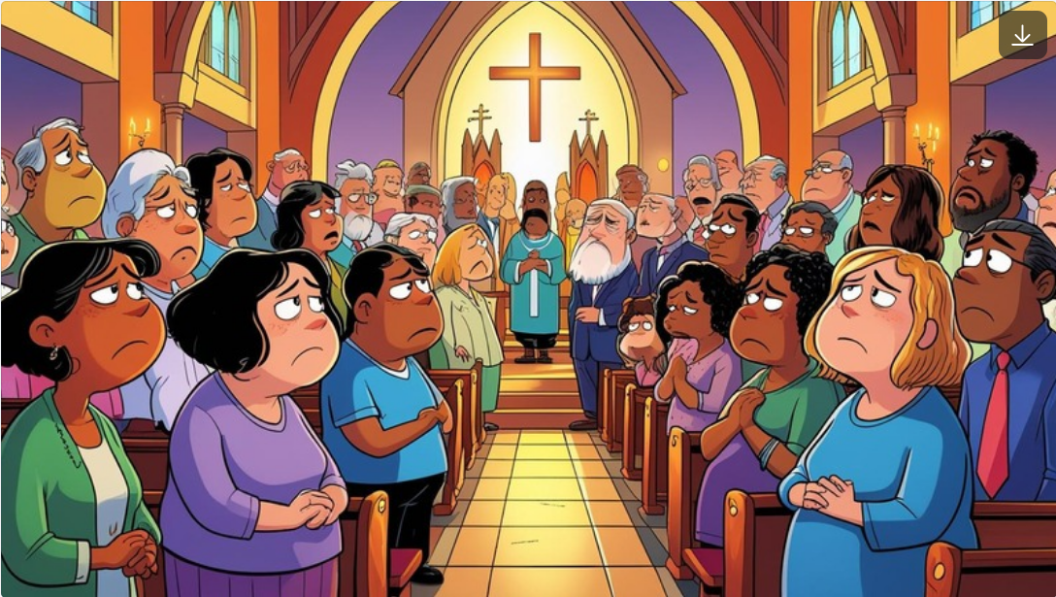

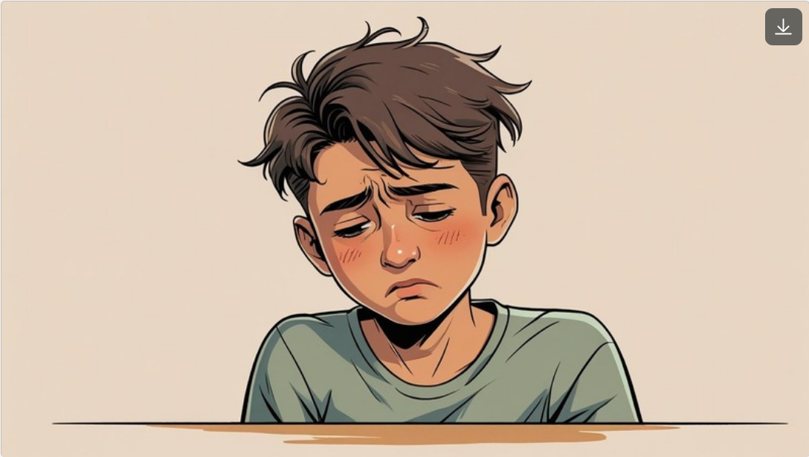
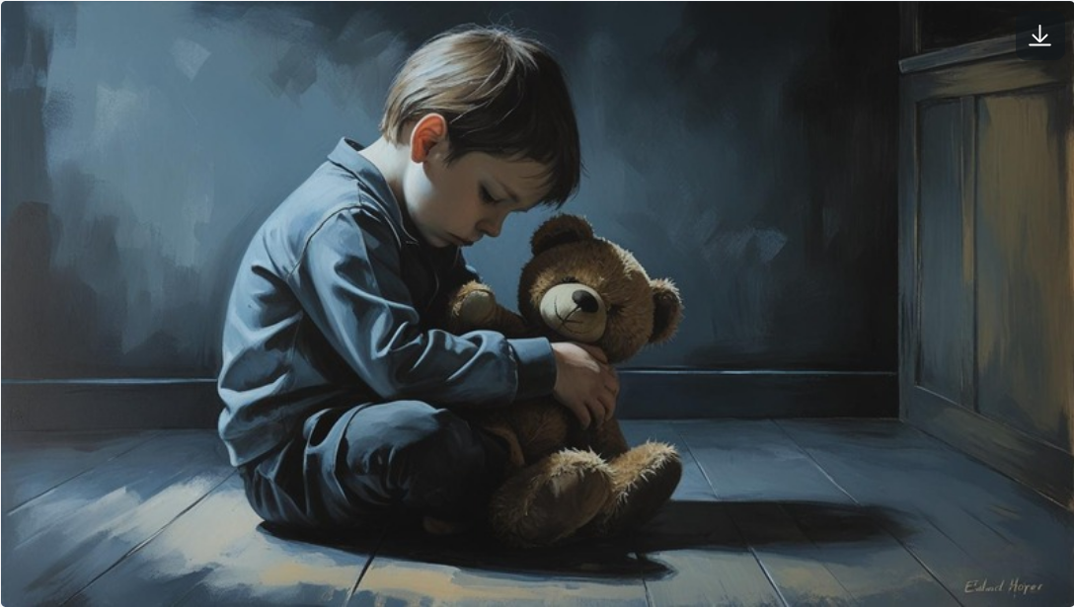
Signs & Indicators of Abuse
Behavioral changes
Unexplained injuries
Withdrawal or fearfulness
Inconsistent stories
Overdependence or avoidance towards certain individuals

Slide 6
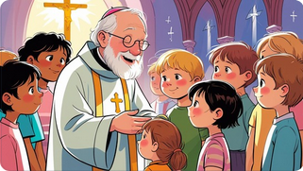
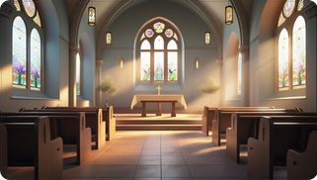
Minister’s Responsibility
Duty of care as shepherds of the flock
Lead by example
Create safe environments in church spaces
Never ignore suspicions or disclosures

Slide 7
Practical Safeguarding Measures
Vetting & background checks for Ministers, CMP, anyone working with Children and vulnerable people as per resolution of conference.
Two-adult rule in children’s ministry
Open-door policy for counselling
Record-keeping of incidents and disclosures
Training volunteers & leaders

Slide 8
MCSA Policy Context
Overview of MCSA safeguarding policy
Book of Order provisions on care & protection
Compliance with national laws in each country

Slide 10
Reporting Procedures
Internal church reporting (to Circuit Superintendent/Bishop)
National legal reporting obligations
Confidentiality vs secrecy — protect victims without hiding abuse
Society
Circuit
District/Bishop

Slide 11
Reporting Procedures as per safeguarding procedure

Slide 12
Case Studies
Interactive scenarios for discussion
Discuss: What should a pastor do?
https://youtu.be/KTJ5DSlPC0U?si=yj5041DABThIXOHn

Slide 13
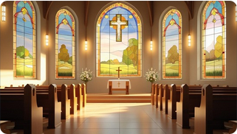

Barriers to Safeguarding
Cultural norms & stigma
Fear of damaging church reputation
Misunderstanding forgiveness & accountability
Lack of training or resources

Slide 14

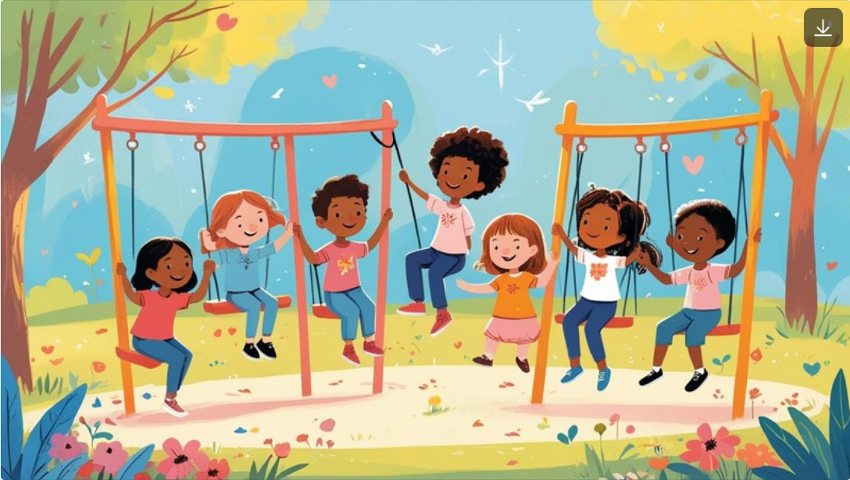
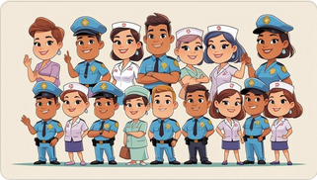

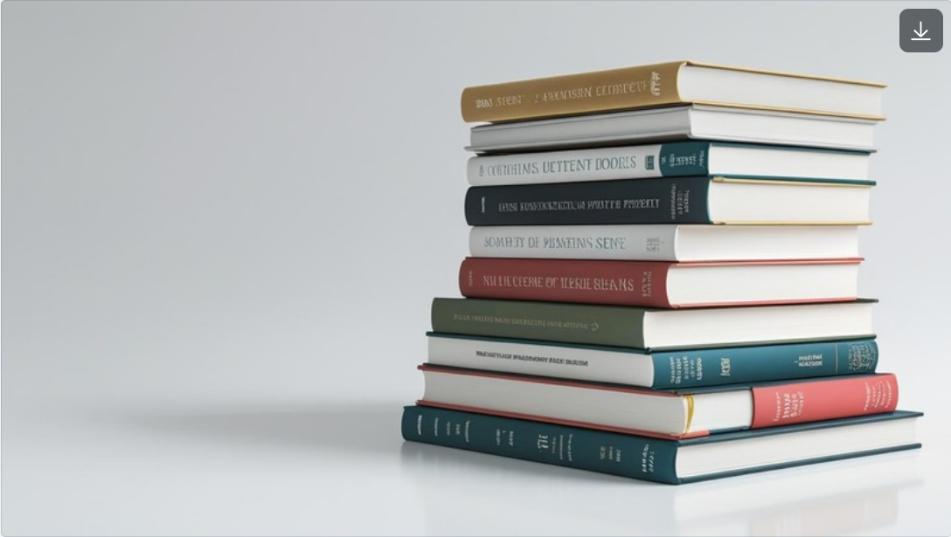

Overcoming Barriers
Strong leadership support
Clear safeguarding policies
Awareness campaigns
Partnership with child protection agencies

Slide 15
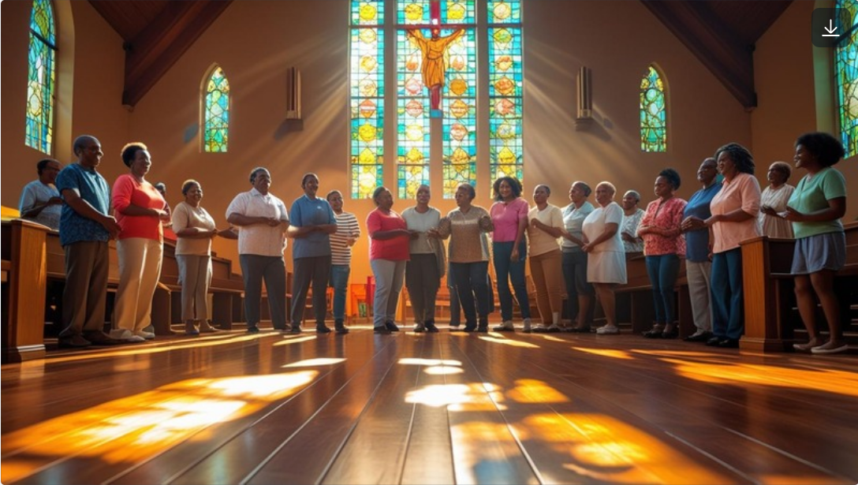
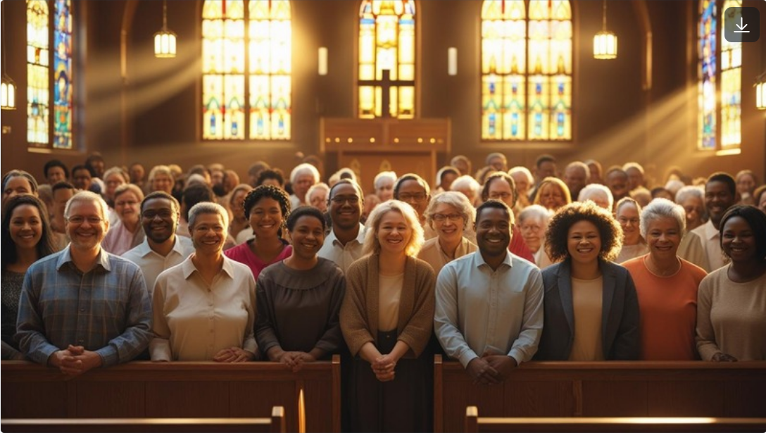

Safeguarding as Ministry
Protecting the vulnerable reflects Christ’s mission
Strengthens trust in the church
Creates a welcoming space for all

Slide 16


Commitment & Next Steps
Reflection: What will I do differently in my ministry?
Commitment to ongoing training
Contact details for safeguarding officers

Slide 17
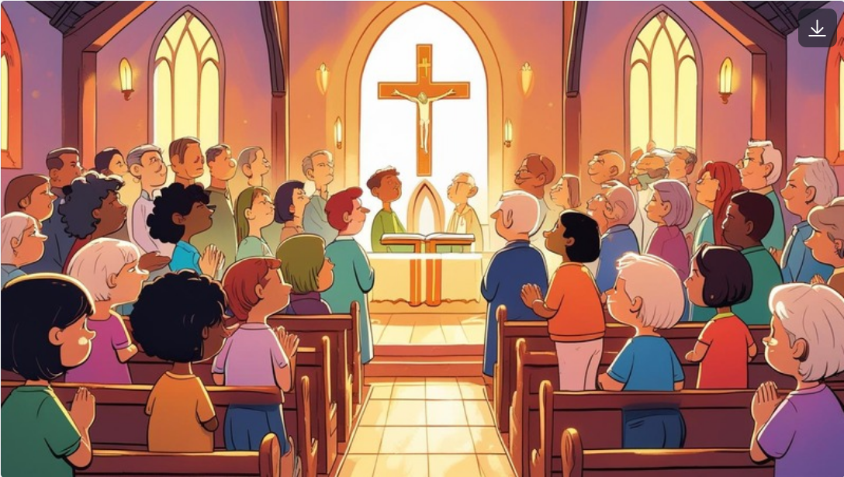
Closing Prayer & Scripture
Micah 6:8 — Act justly, love mercy, walk humbly
Biblical basis: Psalm 82:3, Mark 9:37
Prayer for wisdom, courage, and protection of the flock

Slide 18
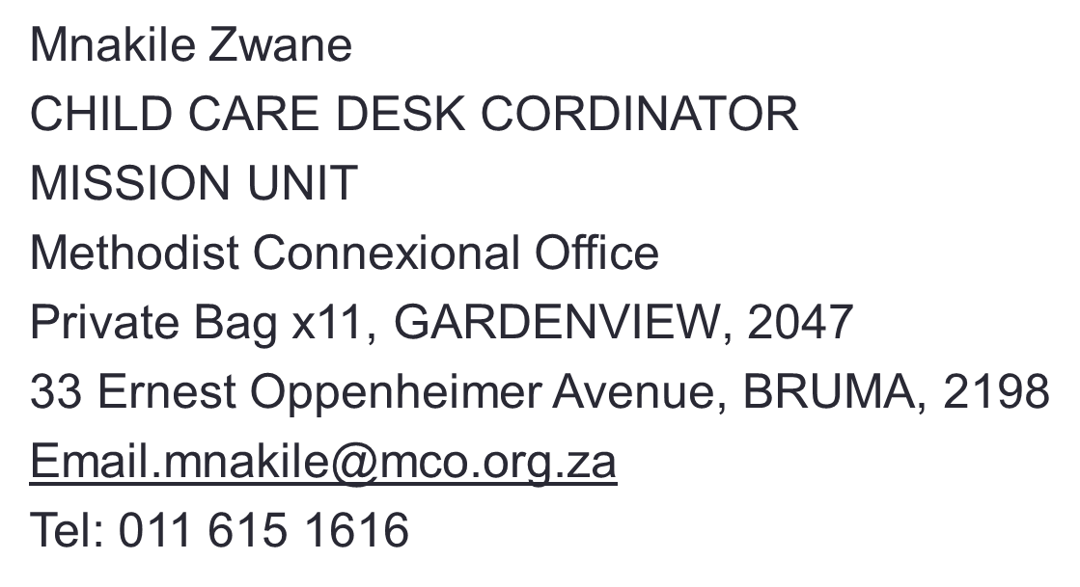
Thank you for the Invitation

